Slide 1
TIPO-LIDANA PRESENTATION
16th of June 2021

Slide 2
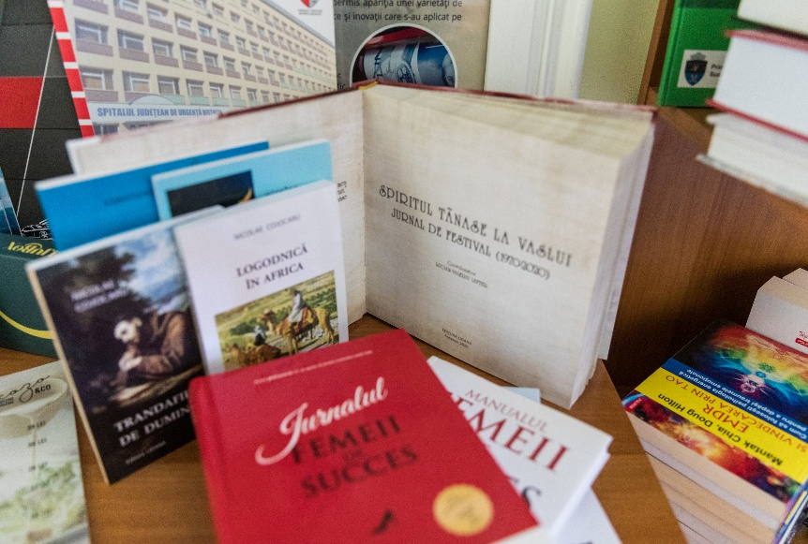
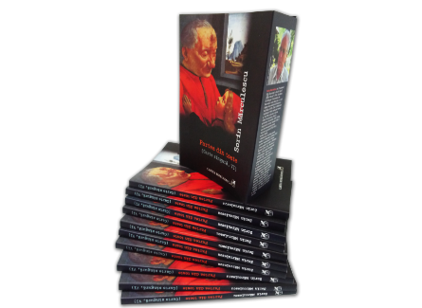
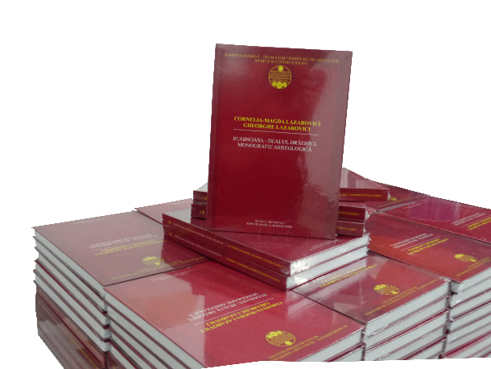
Activity
The relatively new technology, acquired after 2000 and until now, of medium capacity, with competitive technological performances, attracts a lot of clients, both small companies and individuals as well as prestigious companies such as: Polirom SA Publishing House, Humanitas SA, Humanitas Fiction SRL, Union of Poles from Romania, Cartea Romaneasca Publishing House SRL, SC Turist in Bucovina SRL, SC Dimi SRL, SC Promo Plus SRL, Babes Bolyai University, Museum of Bucovina Suceava, Suceava County Police, etc ,. This entails the need for good organization and management of the entire activity involved in the process of production. Main activity:
1812 - other printing activities n.c.a.
5811 - book publishing activities
1814 - binding and related services
1813 - preparatory services for preprinting

Slide 3
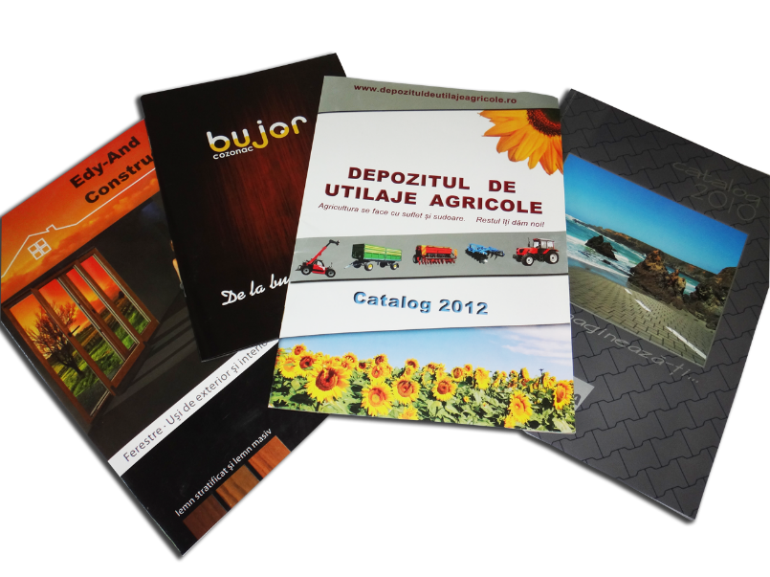
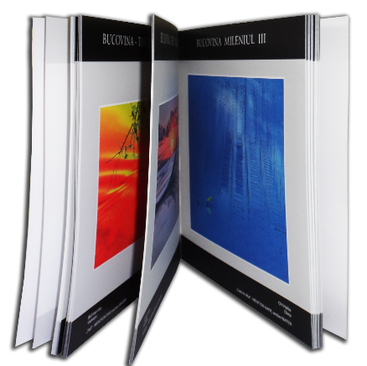
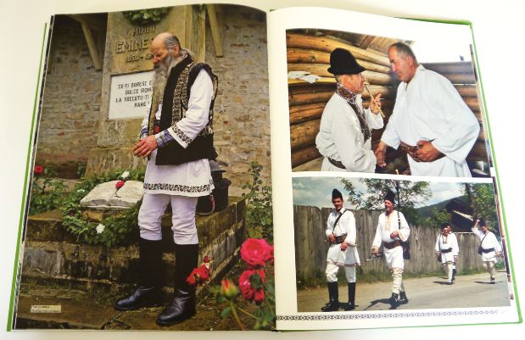
Established since June 2000, the main activity of SC TIPO-LIDANA SRL being production of printing products and services, the activities of S.C. TIPO-LIDANA SRL include the following high quality printing works offered by the "Heidelberg"; "Muller Martini"; "Sthal„ and "Polar” type technology:
Paperback and hardcover books, art albums, presentation catalogs, newspapers, magazines,
brochures, leaflets, posters, greeting cards, business cards
binding works by means of automatic cutting, sewing binding and stapling, folding and creasing machines;
printing finishing works by varnishing and laminating;
various printing and publishing services
a whole range of school notebooks with simple and polychrome covers;
files, folders for office and briefcases, archive boxes;
any type of printed forms;
agendas, notes, notebooks, calendars.

Slide 4
Strategy and relation with SDGs 2030
The company's strategy, communicated within the quality, environment and process policies, aims at the continuous improvement of the performances for each field and respects the motto "MAXIMUM QUALITY PROTECTING THE ENVIRONMENT AND LIFE!".

Slide 5
The general objectives of SC TIPO-LIDANA SRL:
1- expanding the production capacity, by purchasing new and high-performance equipment that will be used to increase the volume of printing services provided and the quality of these services, related to Goal 12: Responsible consumption and production
2- adapting the management system to the modern requirements in the field of printing services, through digitization, which consist of a software for the management of the printing activity, related to Goal 9: Industry, Innovation and Infrastructure
3- increasing the visibility of the company and its offer on the specific market which is related to Goal 8: Decent work and economic growth
4- maintaining a professional team of employees, by training them, which is related to Goal 4: Quality education
5- occupying by SC Tipo-Lidana SRL the leading position on the printing services market in the north-east of the country, by offering high quality services at affordable prices.

Slide 6
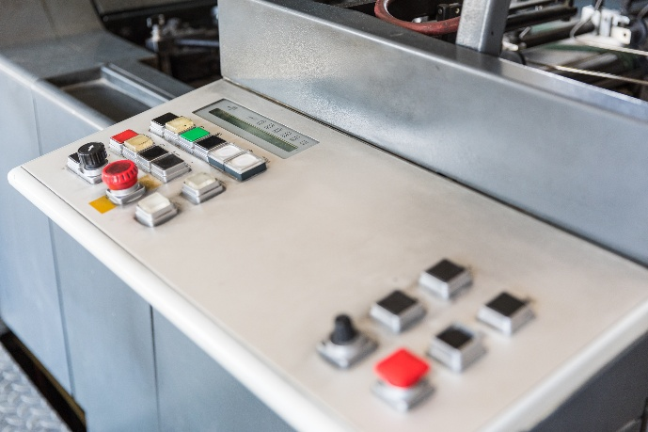
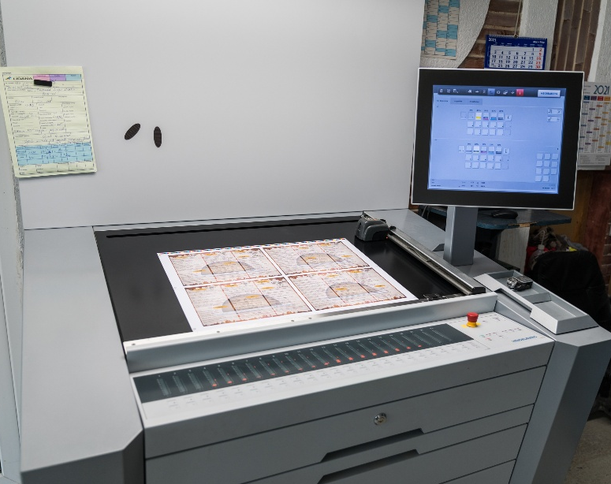
The short-term objectives
meeting customer requirements, needs and expectations through services and products according to specifications;
ensuring the appropriate infrastructure and working environment for the proper conduct of all processes and resources necessary to achieve the objectives set;
modernization of technical equipment;
carrying out the activity in an adequate environment ensuring healthy and safe working conditions;
providing and maintaining equipment and installations in safe conditions;
improving working conditions in safety and health conditions;
developing employees' professional skills and providing appropriate training.
Constantly improving internal and external communication processes, at the level of employees, customers, suppliers and partners, by promoting a climate based on trust, goodwill and stability.

Slide 7
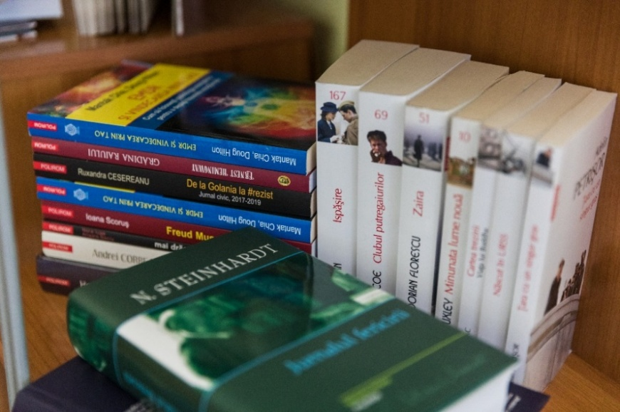
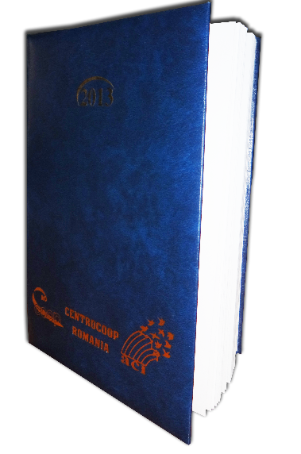
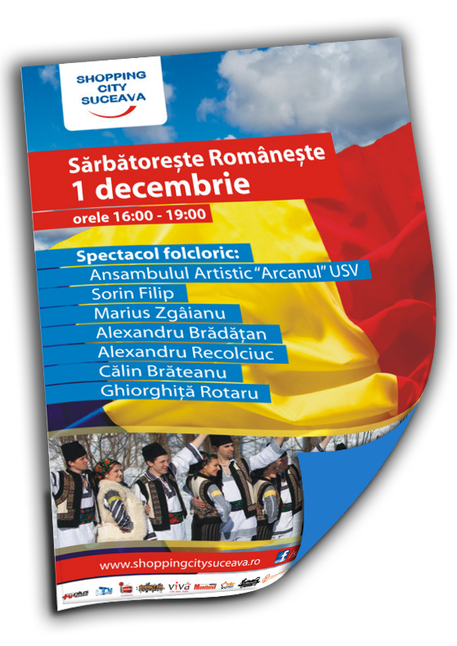
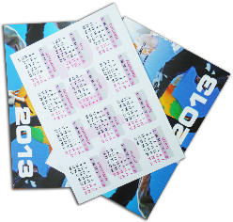
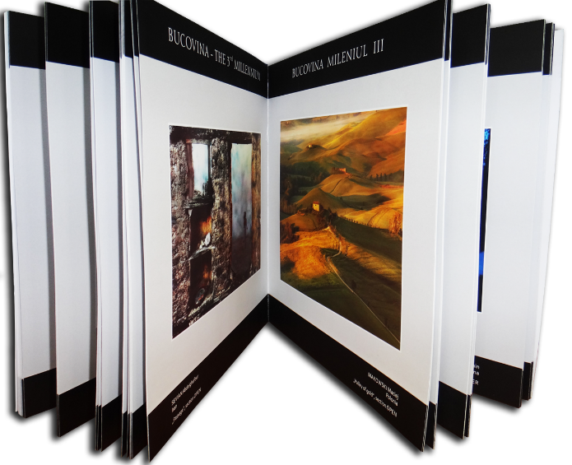
Making printing products
Books
Presentation catalogs, albums
Brochures, magazines
Posters, leaflets, flyers
Stickers, labels
Presentation folders
Correspondence, greeting cards

Slide 8
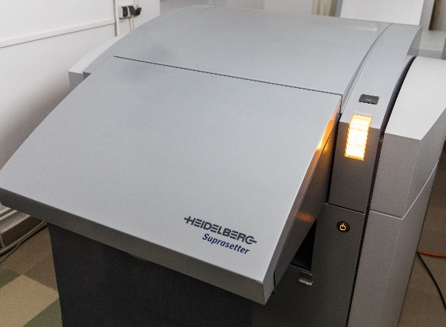
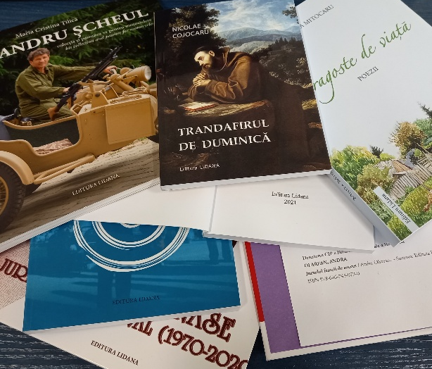
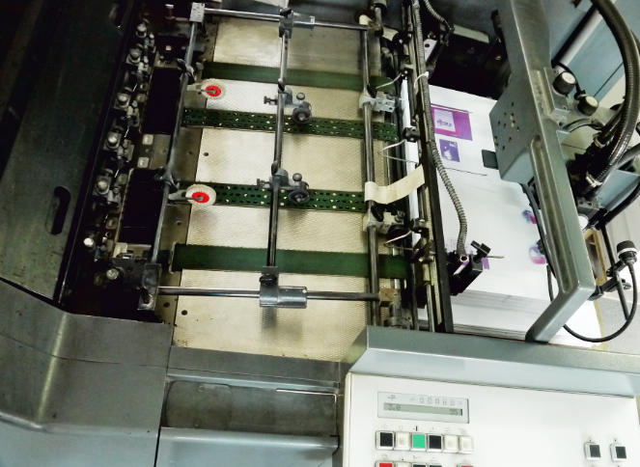
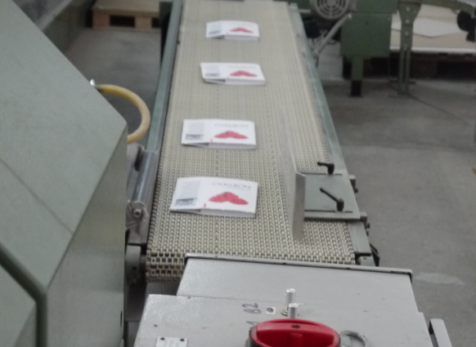
Printing services
• Prepress
Prepress is a term used in the printing industry and represents all the specific processes and procedures that take place before the final offset or digital printing.
• Publishing house
Publishing of books and other periodicals.
• Digital printing
Digital printing allows printing in a relatively short time, in small runs at a convenient price. We currently use high-performance production systems - Versafire EV professional digital printing machine, purchased in 2019, Konika Minolta ensuring speed and versatility, thus meeting the basic requirements of our customers.
• Offset printing
Offset printing allows printing on offset paper, coated cardboard, duplex, etc. with weights between 45 and 350 g / sqm on offset machines at a high quality standard. The technique we have, Heidelberg machines (world leader in the realization of technique and technology for printing) in 1, 2 and 5 color groups + 1 varnish group, allows us to achieve reduced production times at competitive costs in the profile market.
• Binding
In addition to the usual binding finishing operations (folding, interleaving, stapling, creasing, insertion, stitching, etc.) S.C. Tipo-Lidana SRL also offers high quality services in book production (paperbacks and hardcovers).

Slide 9
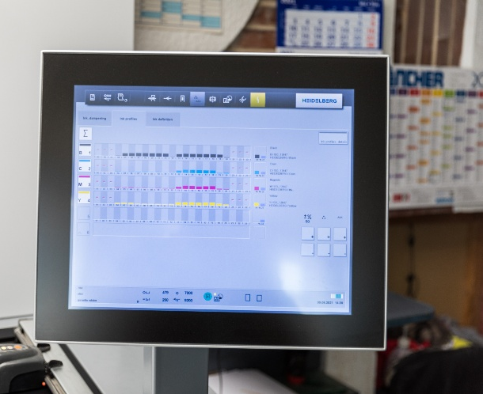
Low price performance
The performance of our equipment allows an increased speed in performing numbers of copies at good prices on the profile market.
The printing services market is constantly evolving, and the quality standards are more and more high.
The adaptation of the services provided to the level of the market standards, by increasing the quality and the volume of the services, required investments in the last years. In 2019, two new machines were purchased, namely: - for offset printing activity - Heidelberg Speedmaster CX 75-5 + L, 5 color groups + 1 group of varnish and pre-press software Flow Easy, and for digital printing - Heidelberg Versafire EV.
These machines increase productivity, while reducing production costs and substantially increasing the quality of final products. All these have the effect of increasing the degree of competitiveness of SC Tipo-Lidana SRL.

Slide 10
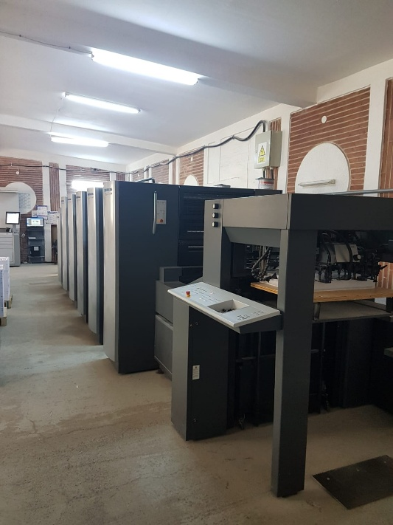
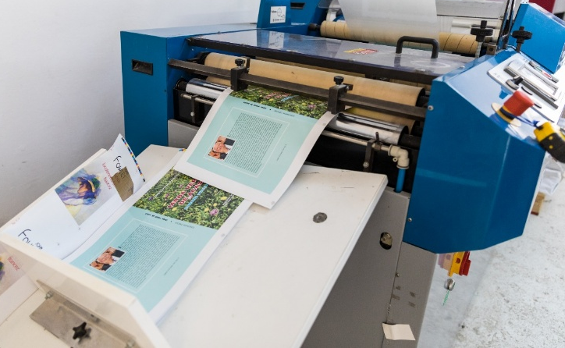
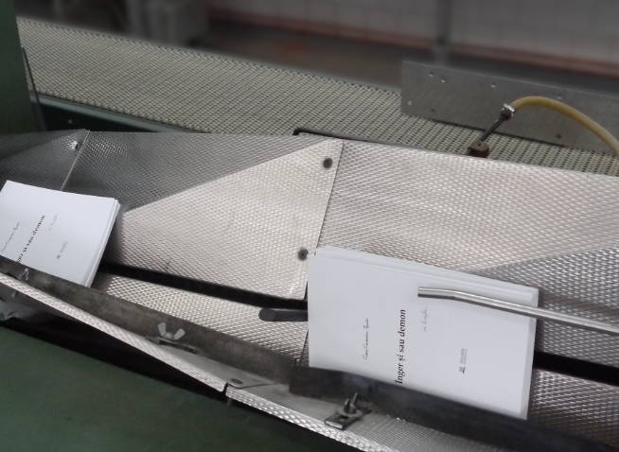
New Equipment
1. Software package for typographic management- PRESS-PREPRESS Flow Easy composed of the following software
a. Prinect Instant Gate - software installed on the control panel of the machine for taking over the CIP3 / 4 machine preset data prepared in PRESS - PREPRESS Flow Easy: data regarding the inking and self-adjustment of the ink areas, data regarding the printing medium and its format etc.
b. PRESS-PREPRESS Flow Easy - the latest generation of workflow for printing preparation and connection to the printing machine. The software resulted from the merging of several software with different functions, having the great advantage of much simpler and faster functions.

Slide 11
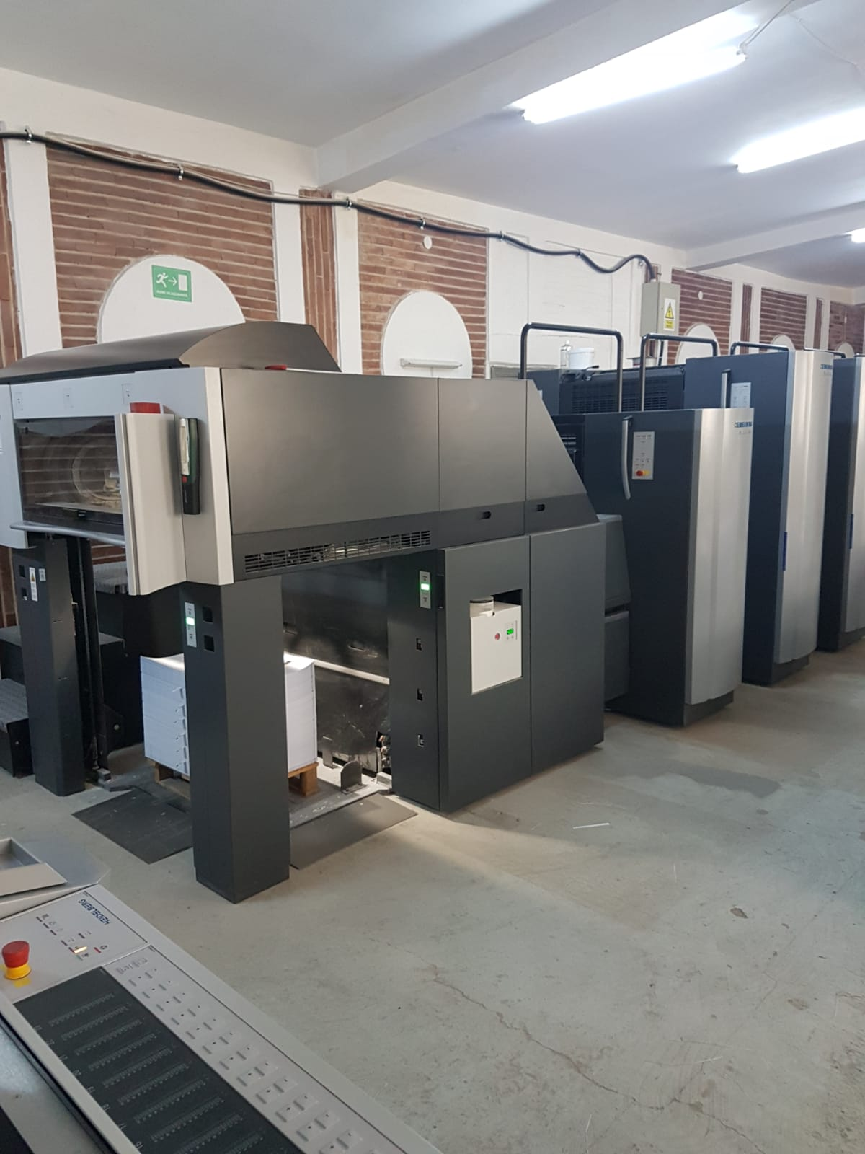
Heidelberg Speedmaster
Offset printing machine with five colors - model CX 75-5 + L Equipment that has incorporated a state-of-the-art technology that includes all existing innovations.
Through its facilities such as automatic washing, low consumption of washing solutions (reducing over 90% compared to manual washing), the possibility of printing with inks based on vegetable oil or ink measuring system and self-control of the machine, has the effect reduction in proportion of over 70% of paper waste, the machine being in accordance with the latest standards in terms of environmental protection and waste recovery. The machine also has low energy consumption.

Slide 12
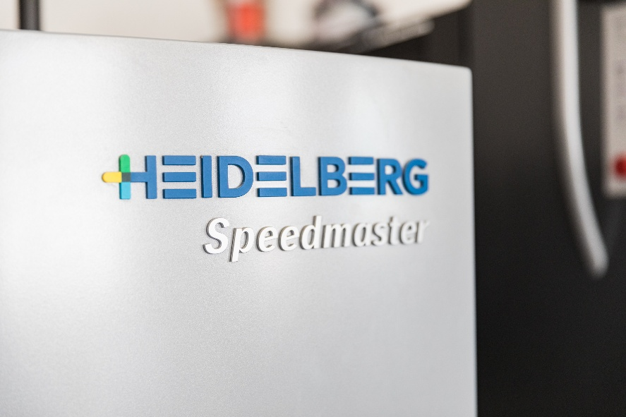
Professional digital printing machine
Heidelberg Versafire EV
The equipment incorporates a state-of-the-art technology that includes all existing innovations. Through the existing equipment, the machine is at the latest standards in terms of environmental protection and waste recovery. Also, the machine has a low energy consumption, being one of the best in its class of machines.

Slide 13
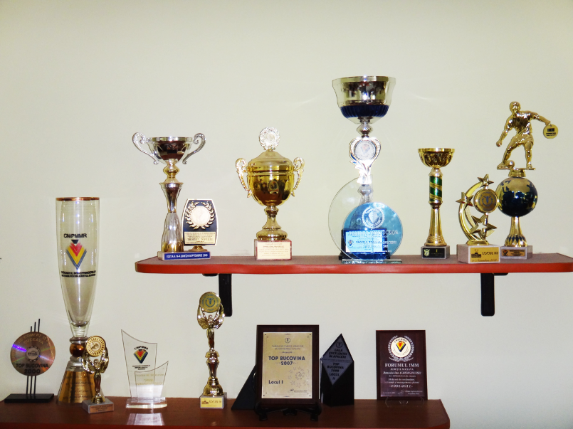
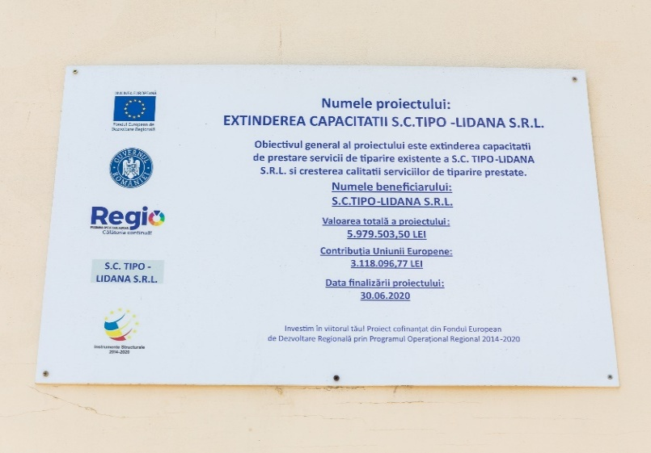
Conclusions
Strenghts:
Location in the industrial area of ​​Suceava, a short distance from heavily trafficked road networks, with an appropriate network of utilities;
The equipment used is new and in excellent working order; It has its own means for supply and distribution, for warranty and post-warranty service activities, including for emergencies; Strong and efficient internal communication system;
Good relationships with customers and suppliers;
Weaknesses:
Decreasing the volume of important investment works in the area;
High cost of spare parts;
Opportunities: customers in the market are loyal; high seasonal demand for some products (services); trends towards modernization, expansion and restoration of road transport infrastructure and prospects for relaunching investments in the area.

Slide 14
Project co-financed from the European Regional Development Fund through the Regional Operational Program 2014-2020

